Slide 1
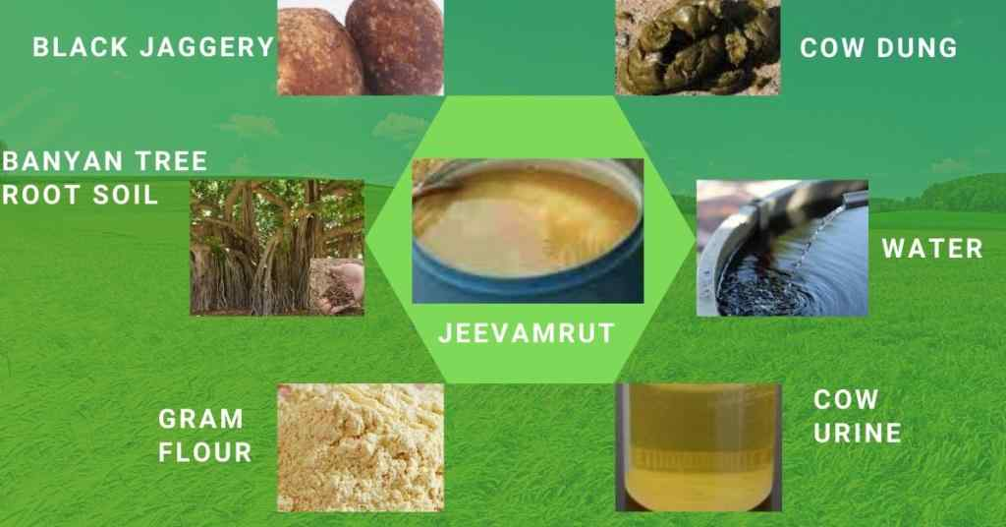
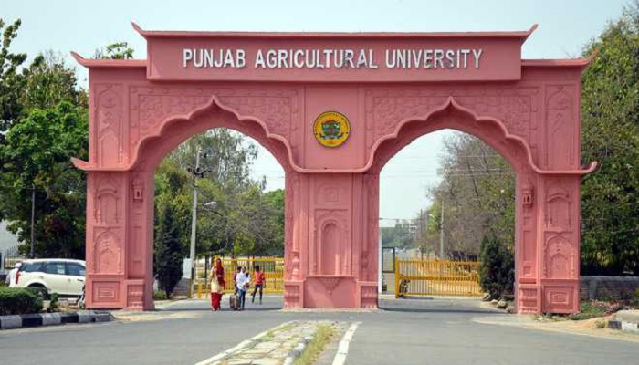
Natural Farming – Concept and Relevance
Dr Amandeep Singh Sidhu Agronomist, School of Organic Farming Co-PI, All India Network Programme on Organic Farming Punjab Agricultural University, Ludhiana, Punjab (INDIA) Ph: +91-9872664899, 7087596648 e-mail: sidhuas@pau.edu

Slide 2
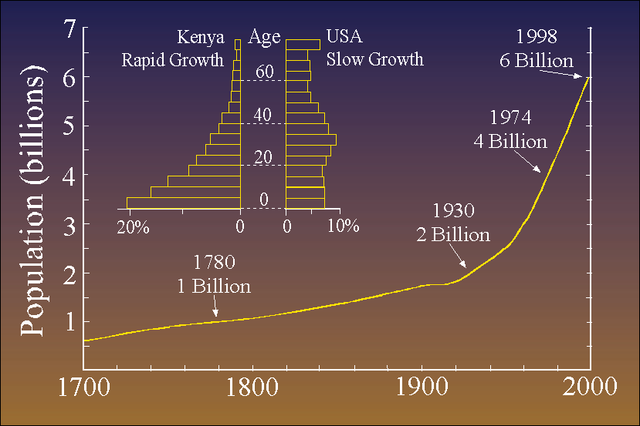
Trends
The onset of the industrial age brought about various trends that have led us to
our present state.
The quick rise in population.
More people to feed.
The greater need for production.
Farms required to produce more.
The increase in urbanism.
Less farms to do more work.
Wide-spread ecological impacts.
Faith in technological, political
and economic fixes.
Today, “less developed countries” are following a similar trend.
Many farmers in these countries choose to grow cash crops rather than subsistence crops.
Regions reliant upon cash crops tend to develop adverse, long term environmental problems.

Slide 3
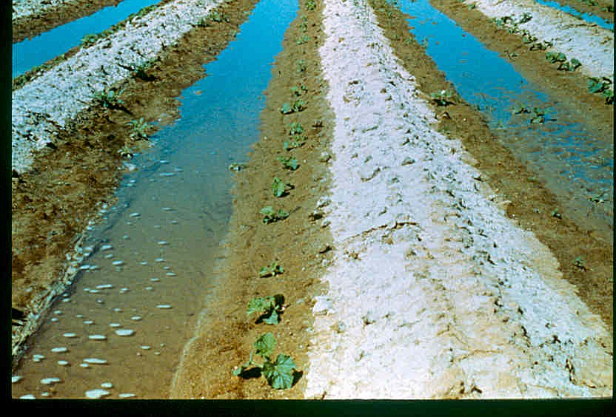
Negative Impacts
Our current mass production style of farming has resulted in numerous
negative side-affects:
Environmental damages
Reduced biodiversity
Habitat destruction
Deforestation
Water, air and soil pollution
Salinization, desertification
Decline in water resources
and land subsidence
Human impacts
Farm land destruction
Damage to soil fertility
Reduced nutritional value of food
Decreased economic, social and cultural values
For the past several years research has looked at sustainable agriculture
as a potential solution to correct and prevent these problems.

Slide 4
Defined
Sustainable agriculture was addressed by Congress in the Food,
Agriculture, Conservation, and Trade Act of 1990. Under that law, the
term sustainable agriculture means “an integrated system of plant and
animal production practices having a site-specific application that will,
over the long term:
satisfy human food and fiber needs
enhance environmental quality and the natural resource base upon which the agricultural economy depends
make the most efficient use of non-renewable resources and on-farm resources and integrate, where appropriate, natural biological cycles and controls
sustain the economic viability of farm operations
enhance the quality of life for farmers and society as a whole."

Slide 5
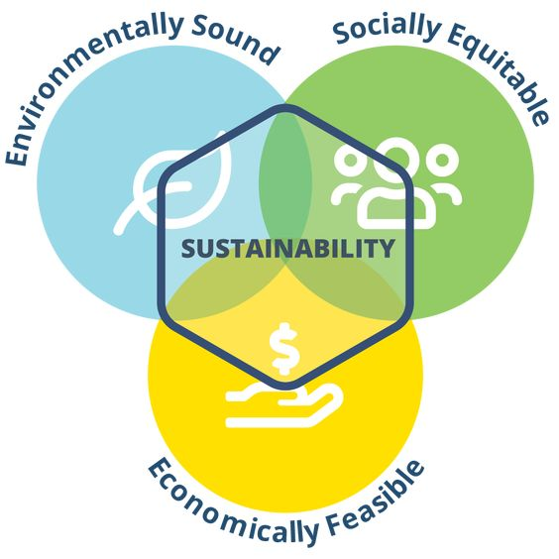

Slide 6
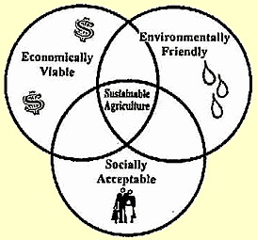
Goal
The goal of sustainable agriculture is to
minimize adverse impacts to the immediate
and off-farm environments while providing
a sustained level of production and profit.
Inherent to this goal is the understanding
that sustainability must be extended not
only globally, but indefinitely in time, and
to all living organisms including humans.
Simply stated, sustainable agriculture refers to the ability of a farm to
produce food indefinitely, without causing irreversible damage to
ecosystem health.

Slide 7
Rules and Regulations
While the goal of sustainable agriculture is similarly defined by numerous organizations, there are no strictly defined rules or regulations for farmers to abide by.
There are standards and certifications for organic farming, which has similarities to sustainable agriculture, but the two not synonymous.

Slide 8
Organic vs. Sustainable
Organic farming excludes the use of synthetic inputs, such as synthetic fertilizers, pesticides, herbicides, and GMOs, whereas sustainable agriculture does not.
Sustainability aims to balance between what is taken out of the soil with what is returned to it, without relying on outside inputs. This is not necessarily a concern of organic farming.
Organic farms constitute only a small percent of farms with a minor impact on the environment. Sustainable agriculture aims to make positive changes on all farms.
In the future, large organic farms that rely on machinery and automation, and purchased inputs, will have similar sustainability issues that large conventional farms do today.

Slide 9
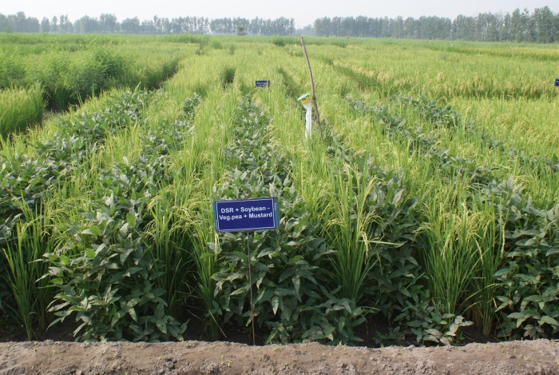
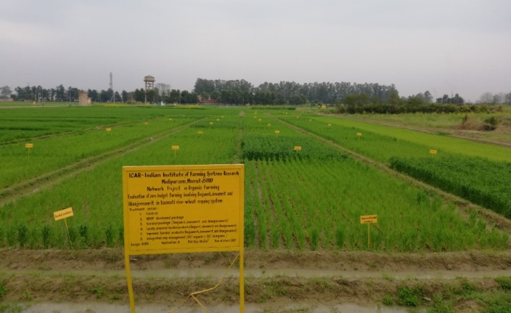
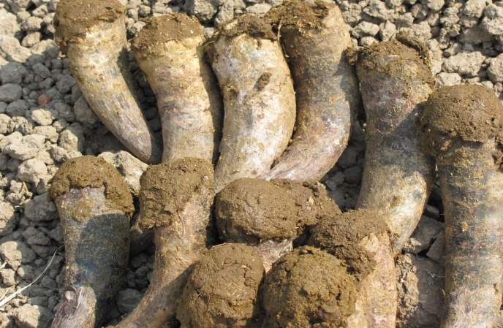
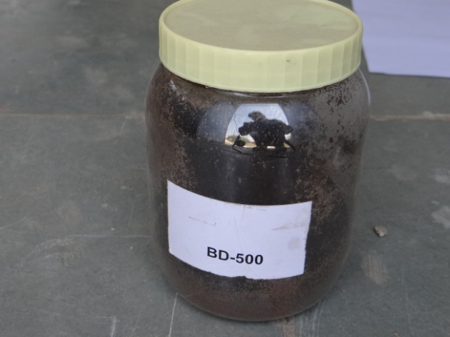
Forms of Bharatiya Prakritik Krishi Paddhati (BPKP)
Organic farming / Jaivik Kheti / Jaivik Krishi
Avoiding or largely excluding synthetics in farming
Meets International Standards
1.6 % area of net cultivated area (2020) to 4 % by 2025
Rs 4500 crores worth products are exported
2. Natural farming
Use of locally prepared cow based products (Beejamrit, Jeevamrit, Ghanjeevamrit & others), Acchdhana, Whapasa and intercropping
Jeevamrit to ensure high soil biological activity
Recycling of biomass, diversified crop stand, cattle urine and slurry
3. Biodynamic farming
Making life giving compost from dead material
Cowpat pit manures such as BD-500 to 507

Slide 10
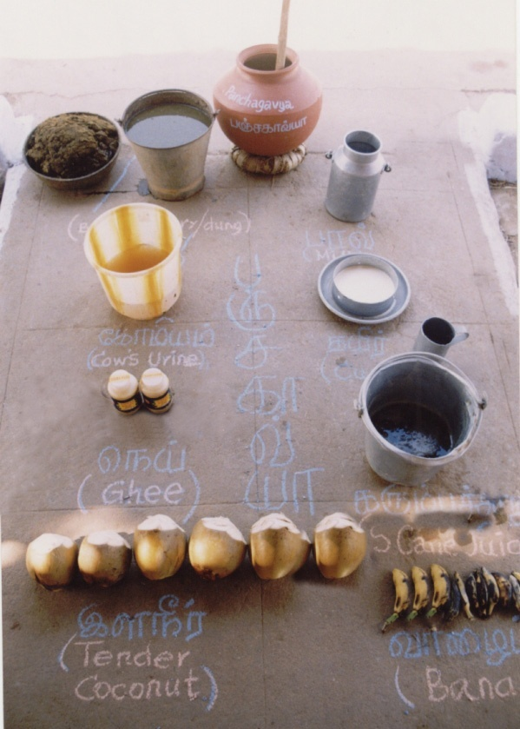
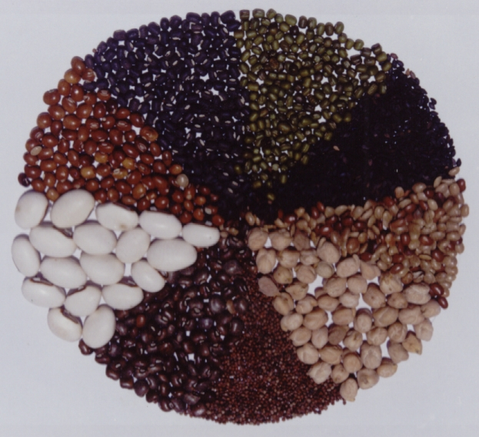
Forms of Bharatiya Prakritik Krishi Paddhati (BPKP)
4. Rishi krishi
Drawn from Vedas
15 kg/ha of virgin rhizopheric soil from banyan tree
Amritpani (ghee, cowdung, honey, water) and virgin soil
Beej sanskar (seed treatment), Bhumi sanskar (soil application) and Padap sanskar (foliar spray)
5. Panchagavya krishi
Prepared from five products of cow: dung, urine, milk, curd and ghee
Enrichment of soil, induce plant vigour with quality production
6. Natueco farming
Neighborhood Resource Enrichment' by `Additive Regeneration' rather than through dependence on external, commercial inputs.
Soil – Enrichment, Roots - Development and Canopy - management
Chickpea
Urdbean
Mungbean
Pigeonpea
Sesame
Sword bean
Horsegram
Ragi

Slide 11
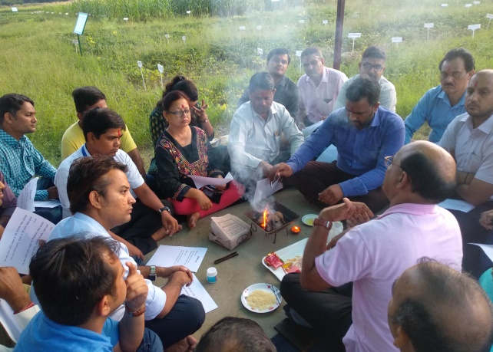
Forms of Bharatiya Prakritik Krishi Paddhati (BPKP)
7. Homa farming
You heal the atmosphere, and the healed atmosphere will heal you
Spiritual practice that dates from the Vedic period
Ash that results from the puja is used to energise composts, plants, animals etc
8. Permaculture / eco-agriculture
Agro-ecological principles
Earthworm and soil bio-diversity development
Sustainability
“Science led promotion of different forms of BPKP (Natural Farming) including Organic Farming is essential”

Slide 12
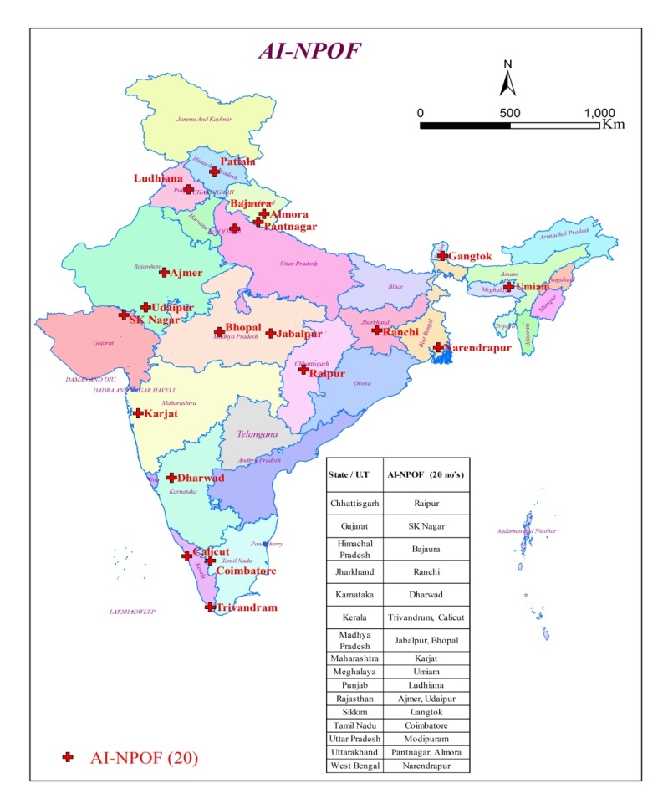
ICAR-All India Network Programme on Organic Farming (AI-NPOF)
2003-04 (13 centres)
2015-16 (20 centres)
16 states
11 SAU’s
7 ICAR institutes
1 Special Heritage University
10 ACZ’s
12 AERs
Proposed to be upgraded in the next SFC
AICRP on Organic and Natural Farming
35 centres including 8 out-reach centres
24 States
17 SAUs, 8 ICAR institutes, 1 CAU & 3 other institutions

Slide 13
NATURAL FARMING
The agronomic phrase “Natural Farming” refers to farming with nature
Emphasis is on “enhanced soil quality and physical conditions by
managing organic matter and soil biological activity
diversified crops & cropping systems
enhanced biomass recycling
biological interactions
It is an attempt to reproduce natural conditions by encouraging integration of crops and livestock so that synergistic effects of different components of the integrated farming system are efficiently and beneficially used

Slide 14
Natural Farming is referred to as the natural way of farming, or do nothing farming, or the Fukuoka Method.
An ecological farming approach introduced in the 1975 book The One-Straw Revolution by Japanese farmer Masanobu Fukuoka.
Natural farming is a subset of organic farming that includes concepts and principles from sustainable agriculture, agroecology, agroforestry, ecoagriculture and permaculture. Natural farming is a closed system that demands no external inputs and closely mimics the natural ecosystem balance.

Slide 15
It advocate complete elimination of synthetic external inputs (fertilizers and pesticides) instead encourage application of natural formulations and concoctions prepared from on-farm ingredients
Promotion of agronomic practices such as reduced tillage; trenching, cover crops, crop rotations, crop residue mulching, intercropping systems, minimal irrigation, coated seeds
Catalysing soil microorganisms to build the fertility of the soil and finally enhance ecosystem services through nutrient cycling, conservation of top soil, increasing water retention, biological N fixation
Natural regulation of pests & diseases
Biodiversity conservation contributing towards the sustainability of agroecosystems

Slide 16
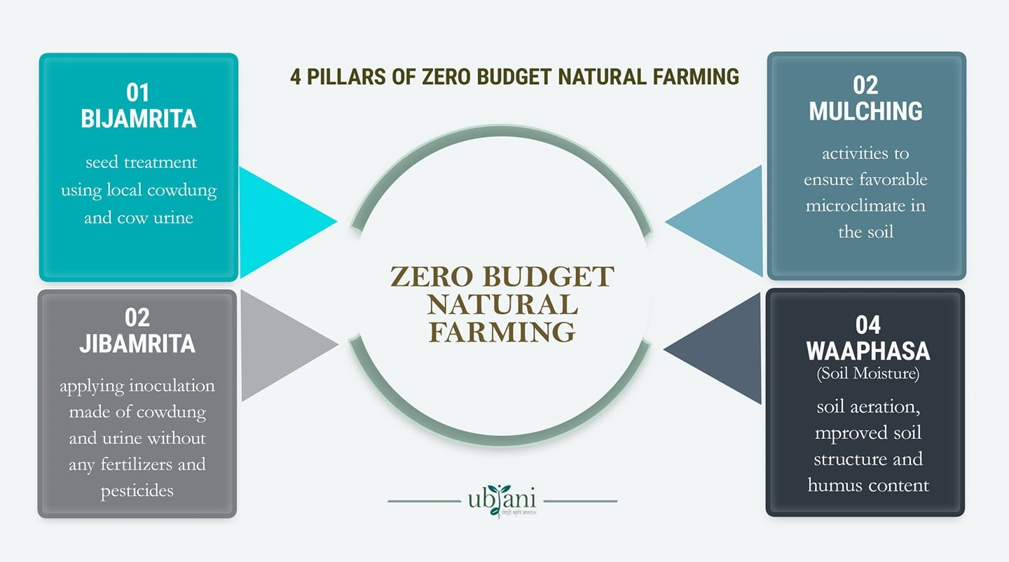

Slide 18
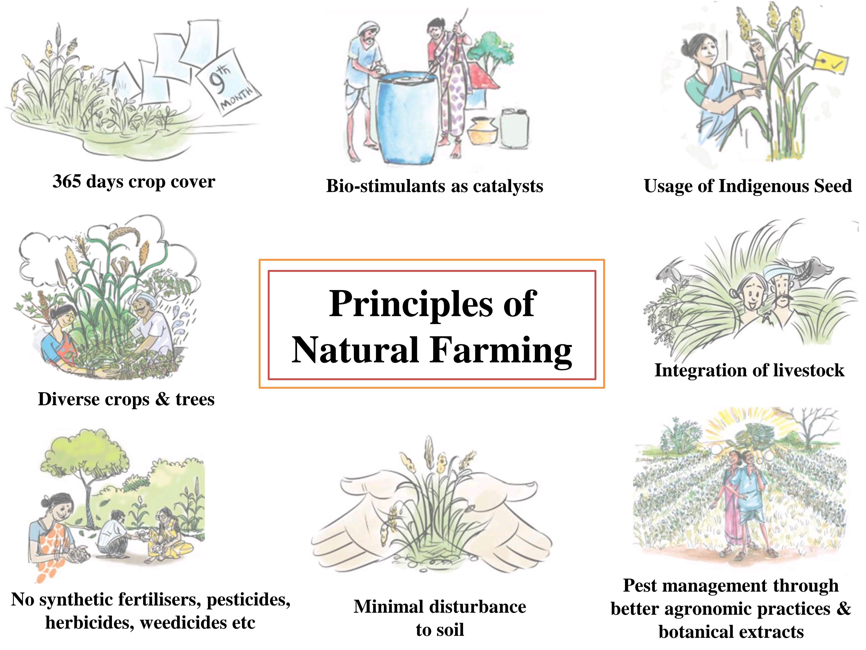

Slide 19
Zero Budget Natural Farming
Subhas Palekar, 2005-06
Four key elements: Beejamrita-seed treatment, Jevamrita- fermented microbial culture, Achhadana- mulching, and Waaphasa; no irrigations.
For small scale operations.
Partial food security.
Mixed use in Punjab.
Mixed results

Slide 20
COMPARISON OF CONVENTIONAL, ORGANIC AND NATURAL FARMING PRACTICES
S. No. | Characteristics | Conventional | Organic | Natural Farming
 | Seeds | HYV, hybrids and GMO | HYV and hybrids | Preferably indigenous and local adapted varieties
2. | Crops and cropping systems | Predominantly monoculture | Diversified cropping system | Polycultures with 8 – 20 crops including agro-forestry
3. | Tillage | Deep tillage | Deep tillage and conservation tillage | Reduced tillage
4. | Seed treatment | Fungicides, insecticides and bio-control agents | Bio-control agents | Beejamrutha
5. | Nutrient management | INM, Synthetic fertilizers, organic and green manures, bio-fertilizers and legume crops | Organic and green manures, enriched compost, non-edible oil cakes, bio-fertilizers, legume crops and bio-dynamic formulations | Jeevamrutha and legume crops

Slide 21
S. No. | Characteristics | Conventional | Organic | Natural Farming
6 . | Weed management | Integrated weed managment and herbicides | Cultural and Mechanical, Soil solarisation, Stale seed bed etc | No specific recommendation
7 . | Plant protection | Integrated pest and disease management- Cultural, Mechanical, Biological, and Chemical | Bio-pesticides, neem based formulation, plant based extract, pest repellent crops, sticky traps, light traps, pheromone traps and inter-cultivation practices | Brahmstra, Neemastra, Agniastra, cow dung+urine, Sore buttermilk
8 . | Irrigation scheduling | Climate, soil and plant based method, Use of sensors, Mobile Apps, Satellite imaging | Fixed interval and variable depth and critical growth stages | Irrigation in noon hours (Whapahasa) without any scientific basis
9 . | Irrigation methods | Surface, Sprinkler and Drip | Surface, Sprinkler and Drip | Alternate furrows
10. | Water use | Medium to high | Medium to high | No scientific evidence

Slide 22
S. No. | Characteristics | Conventional | Organic | Natural Farming
11. | Crop yield | Higher yields | Low to comparable yields | Low yield in control experiments
12. | Produce quality | Moderate to high | High quality produce | No scientific evidence
13. | Input costs | High | Medium to high | Medium based on farmers survey
14. | Net returns | Moderate to high | Moderate to high | Low to medium based on farmers survey
15. | Labour costs | Low to medium depending on crops and farm operations viz: transplanting, harvesting etc | High owing to manual and cultural weed management | No specific recommendation
16. | Food security | Available, affordable and accessible foods | Vulnerable owing to relatively low yields particularly in initial year of conversion | Highly vulnerable due to marked yield reduction
17. | Pesticides residues | Occasional presence of residues on agri-produce and water bodies | Safe, healthy and nutritious food | No specific standards

Slide 23
S. No. | Characteristics | Conventional | Organic | Natural Farming
18. | Pesticides exposure | High | Low | Low
19. | Nutrient leaching | Medium to high | Medium | No scientific evidence
20. | Carbon sequestration | High | Moderate | No scientific evidence
21. | Greenhouse gases | Unit Area basis-High Unit Yield basis-Low | Unit Area basis-Low Unit Yield basis- High | No scientific evidence
22. | Soil life | Low to medium microbial activity | High microbial activity | No scientific evidence
23. | Climate resilience | Medium to high | High | No scientific evidence
24. | Agri-commodities Exports (2020-21) | Standards-Minimum residue limit Value-2.74 Lakh Crores | Standards- NPOP standards Value- 7078.49 crores | Standards: Not formulated so far Area & value: No valid reported data

Slide 24
PRESENT STATUS OF NATURAL FARMING IN INDIA
Natural farming movement led by farmers and civil society has spread to states such as Karnataka, Tamil Nadu, Maharashtra among others in the last few decades.
Chemical-free agriculture, popularly known as organic agriculture, has been gaining importance in India since 2000.
The NITI Aayog has also emphasized on ‘natural farming’. However, community organization and farmers use ‘organic’ and ‘natural’ farming terms interchangeably.
It is roughly estimated that around 2.5 million farmers in India are practicing regenerative agriculture.
In the next 5 years, it is expected to reach 20 lakh hectares- in any form of organic farming, including natural farming, of which 12 lakh hectares are under Bharatiya Prakritik Krishi Padhati (BPKP).
States such as Andhra Pradesh, Himachal Pradesh, Gujarat, Haryana, Karnataka and Kerala are promoting natural farming.
Andhra Pradesh is the front runner among all states in implementing natural farming programme at a mass scale

Slide 25
Karnataka recently initiated implementation of zero budget natural farming (ZBNF) on a pilot basis in 2,000 hectares in each of the 10 agro-climatic zones of the state.
Himachal Pradesh has also set an ambitious target of promoting natural farming in entire state by 2022.
It has claimed to exceed its targets of year 2019 by covering more than 50,000 farmer familie Kerala, Gujarat, Haryana and Rajasthan have conducted multiple mass level awareness programmes, trainings and workshops for hundreds and thousands of farmers to promote natural farming.
As per 17th Loksabha standing committee on agriculture report dated March, 2020, The Ministry of Agriculture and Farmers Welfare (MoAFW) proposed ‘Bhartiya Prakritik Krishi Padhati’ (BPKP) as a new sub-mission under Paramparagat Krishi Vikas Yojna (PKVY).

Slide 26
KEY CHALLENGES TO SCALE-UP NATURAL FARMING IN INDIA
Limited buy-in from line ministries and wider research ecosystem
Limited awareness among farmers
Lack of enabling production and marketing ecosystem
Limited safety nets and incentives to enable the transition

Slide 27
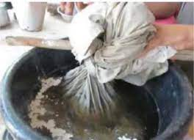
Beejamrit

Slide 28
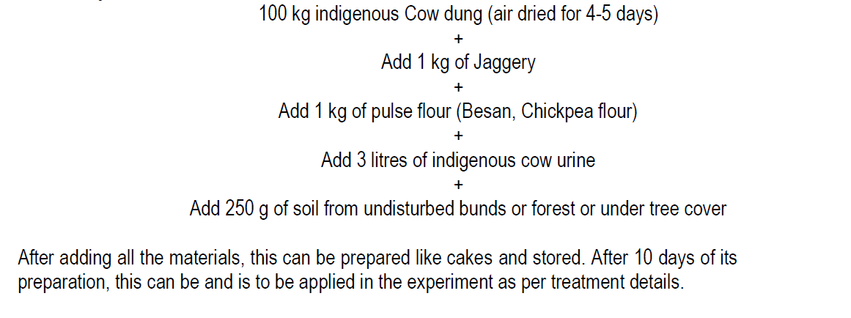
Ghanjeevamrit

Slide 29
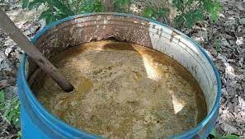
Jeevamrit
Take plastic drum of 250 litres capacity
add 10 kg of fresh cow (indigenous) dung + 10
litres of indigenous cow urine + 2 kg of Jaggary + 2 kg of pulse flour (Basan, Chickpea
flour) + 150 g of soil from undisturbed bunds or forest or under tree cover in 200
litres of water
mix thoroughly
Keep the drum in shade covering with gunny bag or cotton cloth or plastic mosquito net
Stir the mixture for 5-10 minutes for twice a day (morning and evening) with wooden stick
Jeevamrit is ready for application at 9th day
It can be applied up to 12th day from its preparation.

Slide 30
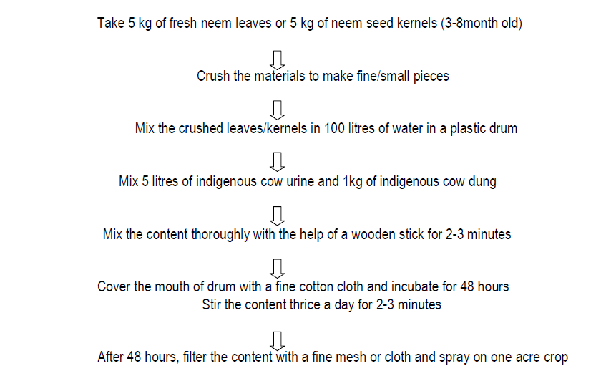
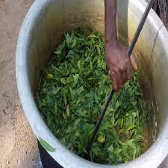
Neemashtra

Slide 31
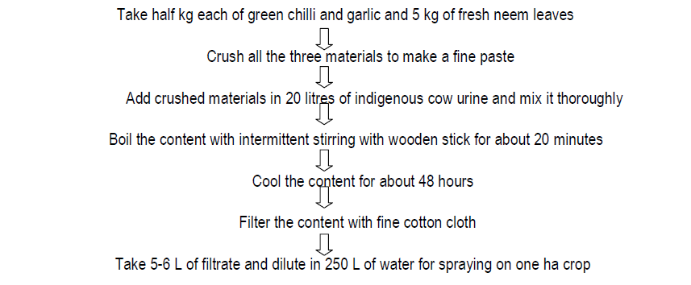
Agniashtra

Slide 32
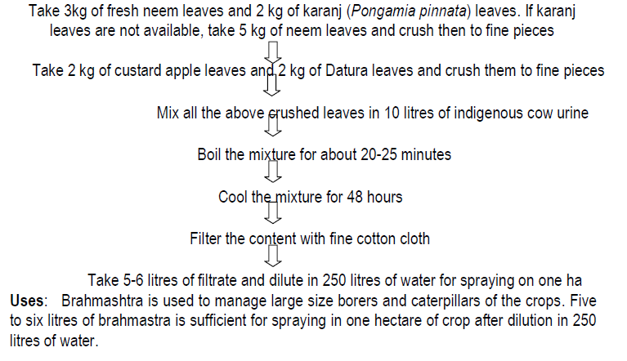
Brahmashtra

Slide 33
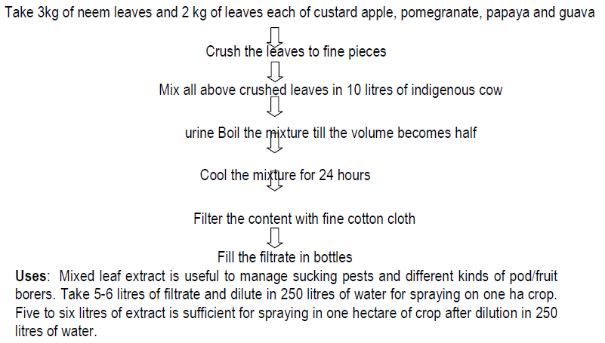
Mixed leaf extract (decoction)

Slide 34
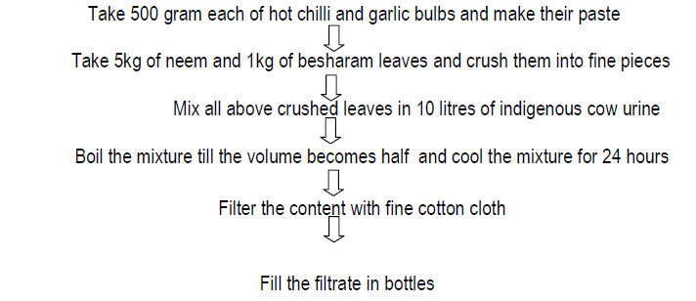
Chilli - garlic extract

Slide 35
Both soil and water belong to the biosphere,
to the order of nature,
and-as one species among many, as one generation-among many yet to come,
we have no right to destroy them
Daniel Hillel
Out of Earth
THANK YOU
EAT ORGANIC
DREAM ORGANIC
LIVE ORGANIC

